Slide 1


5G Wireless Technology
Presented By,
Rithika Anilkumar S1 CSEA 55

Slide 2
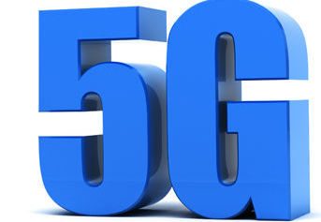
ORGANISATION OF PRESANTATION
What is 5G?
Evolution of wireless Technology
How is 5G better than 4G?
How fast is 5G?
5G Usages
How does 5G work?
Impact of 5G
Importance of 5G
Conclusion
References
2

Slide 3
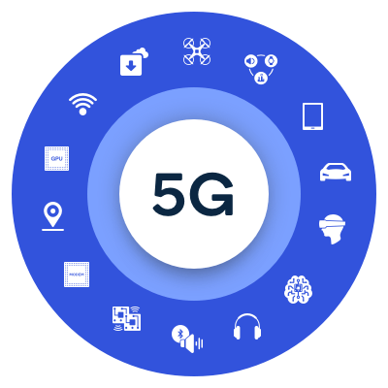
What is 5G?
5th generation mobile network
Deliver higher multi-Gbps
peak data speeds
Ultra low latency, more reliability, massive network capacity, increased availability
qualcomm.com

Slide 4










Evolution of mobile wireless Technology
Mobile voice communication
Efficient voice to reach billions
Focus shifts to mobile data
Mobile broadband and emerging expansion
A unified future-proof platform
1980s
Analog voice
AMPS
1990s
Digital voice
GSM, CDMA
2000s
Wireless Internet
CDMA2000, HSPA
2010s
Mobile broadband
LTE, LTE Advanced,
Gigabit LTE
2020s
Wireless Edge
5G New Radio
(NR)

Slide 5
How is 5G better than 4G?
Unified platform, more capable than 4G
Spectrum usage better than 4G
Faster than 4G
More capacity than 4G
Lower latency than 4G
5

Slide 6
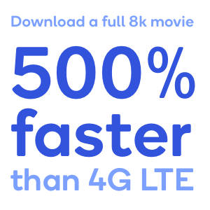
Designed to deliver peak data rates up to 20 Gbps
Designed to provide more network capacity
by expanding into new spectrum, such as mmWave
How fast is 5G?
Data rates stay consistently high using Gigabit LTE coverage foundation
qualcomm.com

Slide 7

Scalable OFDM (Orthogonal frequency-division multiplexing) - based air interface
How does 5G
work?
qualcomm.com
New 5G NR (New Radio) air interface
achieved by new self-contained TDD subframe design

Slide 8


5G Usages
Enhanced mobile broadband
Mission-critical communications
In the massive IoT area
5G mobile technology make VR and AR faster
5G transform industries into remote control of critical infrastructure, vehicles, medical procedures
Connect massive number of embedded sensors

Slide 9









5G Usages
Text recognition
Face
detection
Voice
activation
Voice recognition
Object classification
Computational photography
Anomaly detection
Landmark detection
Fingerprint
Contextual
awareness
On-device
security
Gesture/ hand tracking
9

Slide 10






Wearable devices with AI (Artificial Intelligence) capabilities
(Global) network. Media independent handover
Radio resource management. VOIP (Voice over IP) enabled devices
With 6th sense technology
aliexpress.com
Remote surgery
27
5G Usages

Slide 11
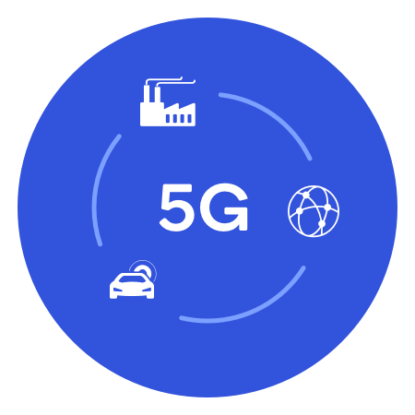
Impact of 5G
Change internet service to wireless system
5G may become an alternative to
Fiber
DSL (Digital Subscriber Line)
Cabled solutions
27
11

Slide 12
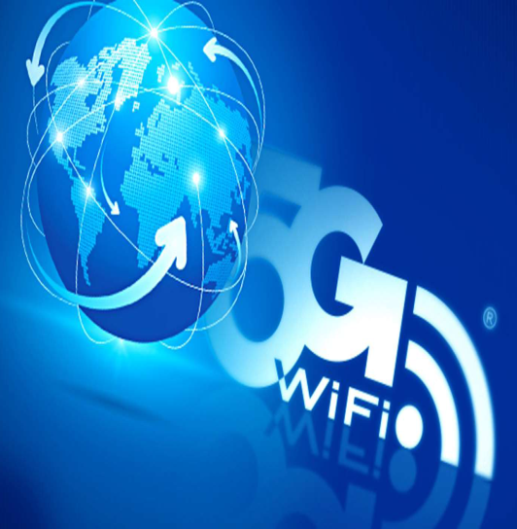
Impact of 5G
High Speed, High Capacity
5G technology providing large broadcasting of data in Gbps
Multi - Media Newspapers, watch T.V programs with the clarity as to that of an HD Quality.
Faster data transmission that of the previous generations
27
12

Slide 13
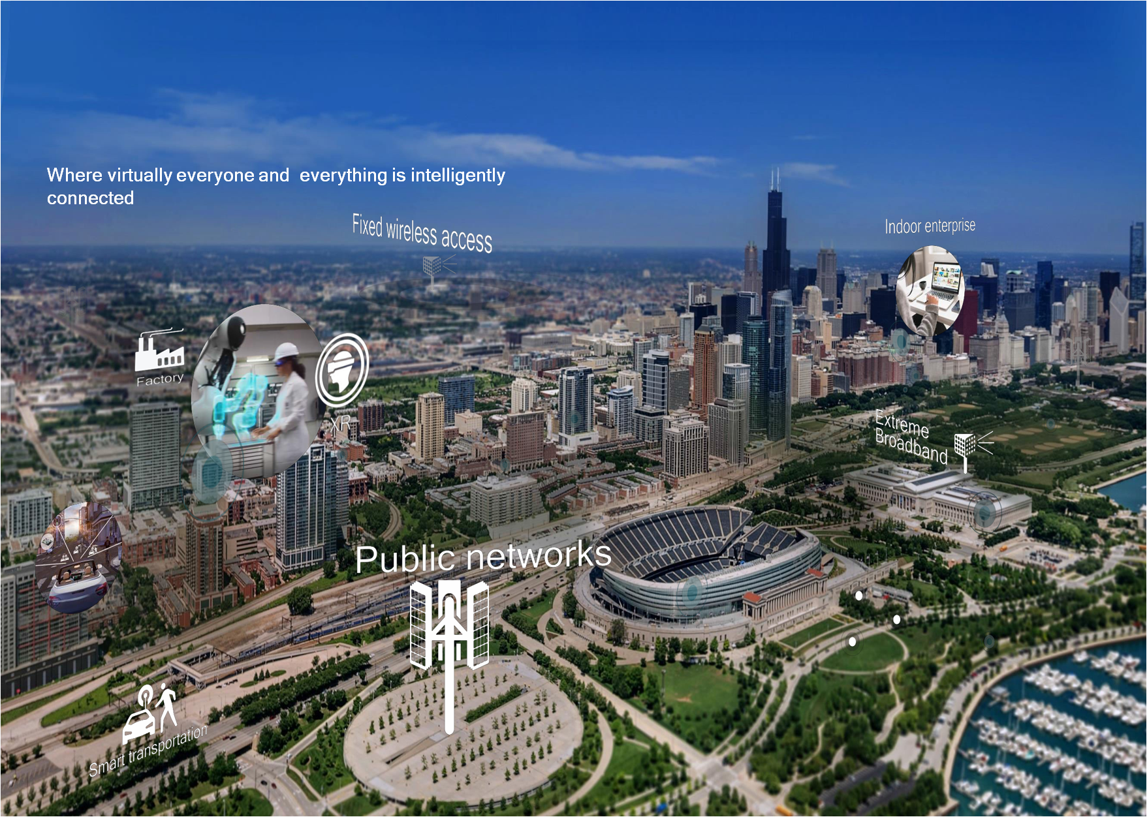
Impact of 5G

Slide 14

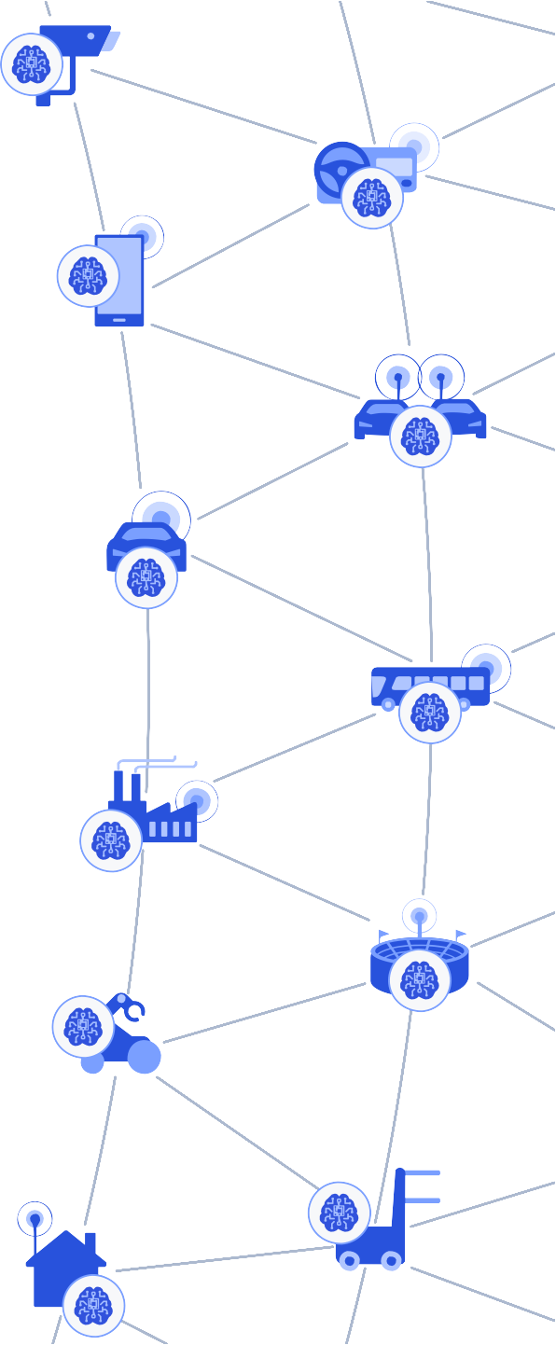










Importance of 5G in digitized world
Past
Cloud-centric AI
AI training and AI inference in the central cloud
Today
Partially-distributed AI
Power efficient
on-device AI inference
Future
Fully-distributed AI
With lifelong on-device learning
On-device
7

Slide 15

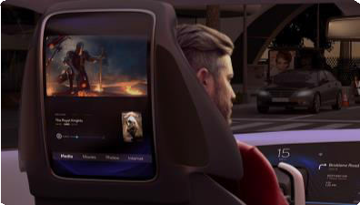




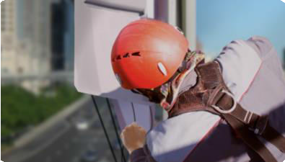





—
initially with R14 C-V2X
Expand eMBB to vehicles
Expand mobile gaming including cloud gaming
Expand fixed wireless access, integrated with Wi-Fi
Expand 5G coverage and performance
Expanding our eMBB solution beyond the smartphone
Expand device classes to always connected PC/Laptop
Expand experiences, like XR tethered to smartphones
Expand reach with our small
cell solutions
Qualcomm.com

Slide 16
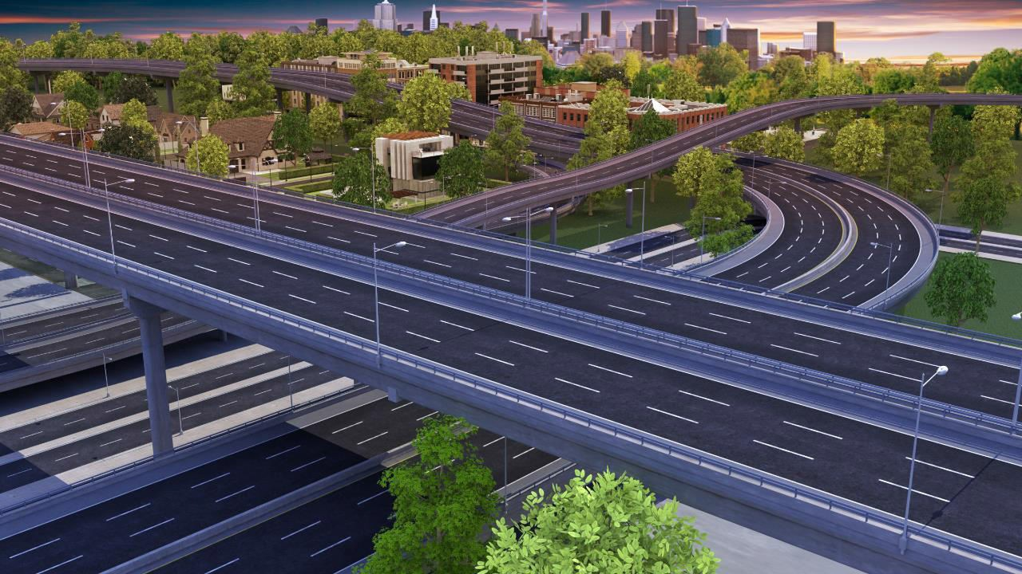

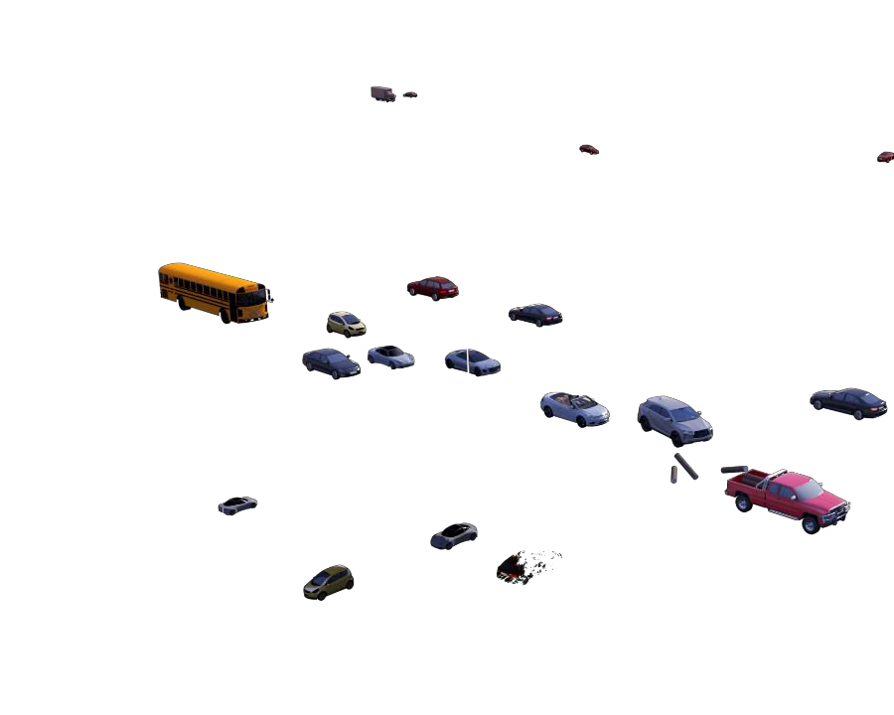













Massive
29
Enhanced network communication
Faster access to cloud for in-vehicle experiences, car OEM services and telematics
New direct communication
V2V, V2I, and V2P communications for latency-sensitive use-cases, e.g. collision avoidance
Internet of Things
Deeper coverage to connect road infrastructure (e.g. sensors and traffic cameras)
V2N
V2N
V2I
Smart city
Road hazard waning
RSU
Speed
harmonization
Sensors
Utilities
V2V
Connected car services
In-vehicle experiences
Road safety
Transportation efficiency Connected road sensors
Evolution to 5G is designed to serve as the unified connectivity

Slide 17
Conclusion
Today’s wired society is going wireless and if it has problem, 5G is the answer.
5G technology is going to be new revolution in wireless system markets.
It will be available in the market near future and affordable
cost effective with more reliability than previous mobiles.
5G will be compatible with all previous infrastructure.
5G will provide a faster data delivery to customers

Slide 18
Reference
www.qualcomm.com & www.qualcomm.com/blog

Slide 19
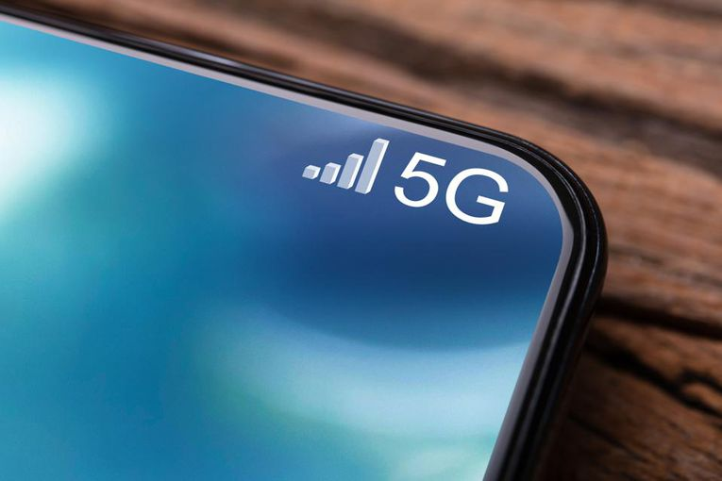
THANK YOU

